Slide 1




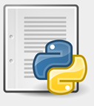





Stock Rest API
AWS Cloud
Extract json from API
Using Python Script
Backup S3 Bucket
Amazon CloudWatch
Writing data to Kinesis Delivery Stream
Amazon Kinesis
Data Firehose
Python Script
Results
BI Tool
Time Series Forecast
SQL Query
Amazon Redshift
JDBC Connector

